Slide 1
Revolutionizing skin cancer detection
Using AI for early diagnosis
By: Jaymy Foister
Notes:
Hello, I am Jaymy Foister. I did my Final project on a new way to revolutionize skin cancer detection by using AI for early diagnosis.

Slide 2
Midterm research recap
Notes:
For those of you who have not seen my midterm presentation video, I will recap some of the information I went over in that presentation. My midterm presentation video is available to those who wish to watch it.

Slide 3
The Problem
What is the problem?
Early detection is crucial in the fight against skin cancer.
1 in 5 Americans will develop skin cancer within their lifetime.
Why should this problem be solved?
Early treatment can greatly improve the chances of a successful outcome.
How will I know this problem has been solved?
The problem will be solved when everyone has access to this cancer recognition AI system.
Who has this problem?
Notes:
AI is able to speed up the initial appointment and testing phase as it narrows down which skin lesion is more crucial to test

Slide 4
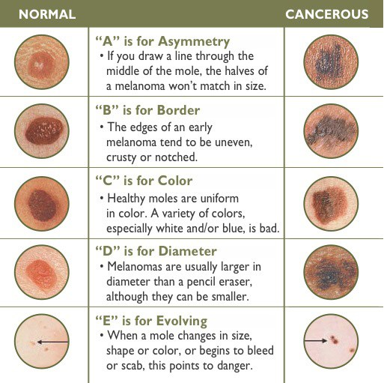
Background Information
The two kinds of skin cancer that are most important to identify are:
Keratosis – most common type of skin lesion
Melanoma – most deadly type of skin lesion
Both types of skin lesions can either contain:
Malignant cells – abnormal cells that divide without control and invade other tissues
Benign cells – noncancerous cells that do not spread or invade other tissues
Dermatology ABC’s to identify skin lesions shown through pictures given by Texas Surgical Dermatology PA
Notes:
There are three major types of skin cancer — basal cell carcinoma, squamous cell carcinoma and melanoma

Slide 5


Stanford skinskan
In 2017, a team of seven Stanford representatives, lead by Andre Esteva, created and trained a CNN using “a dataset of 129,450 clinical images” to detect skin cancer.
This Stanford CNN was intended for clinical use as it was trained with Inception v3 and had 55.4 ± 1.7% of accuracy.
According to the research, "two dermatologists attain 65.56% and 66.0% accuracy on a subset of the validation set.“
Stanford Health Care has been reporting on new apps from 2022 to now being developed using the research above.
In 2019, the MiraLoma Melanoma Team entered their SkinSkan app model into the Health Hackathon contest and won.
SkinSkan was inspired by Stanford’s research of a trained CNN that can detect skin cancer based on an image. SkinSkan model information:
28x28 RGB image training data mostly for faster training time and less variation in imaging.
Standard LeNet CNN
Four possible outputs to the user:
Melanoma (Malignant/Benign)
Keratosis (Malignant/Benign)

Slide 6
Task environment Chart
Agent Type | Performance Measure | Environment | Actuators | Sensors
Skin cancer diagnosis system | Healthy patient Reduced costs Publicly available | Patient Hospital staff | Laptop with user’s skin lesion images Display of diagnoses and next steps | Photo recognition of skin cancer Keyboard entry of patient’s input
Notes:
Applying some of the information from lecture, we will look at the task environment chart for skin cancer diagnosis system.

Slide 7
Final project
Notes:
Now we will go through what I have accomplished since my midterm research was conducted.

Slide 8
CNN search
ISIC - International Skin Imaging Collaboration growing dataset since the website is open to user image input
Not a lot of CNNs available that were trained with the ISIC
See the ISIC trained CNN on Final_Test1code and the SIIM-ISIC trained Final_Test4 code
HAM10000 - dataset of 10000 training images for detecting pigmented skin lesions
More HAM10000 trained CNNs readily available
See the HAM10000 CNNs on codes Final_Test2, Final_Test3, and Final_Test5
Notes:
The dataset for ISIC 2019 contains 25,331 images available for the classification of dermoscopic images
We will go through these codes in the next slide.

Slide 9
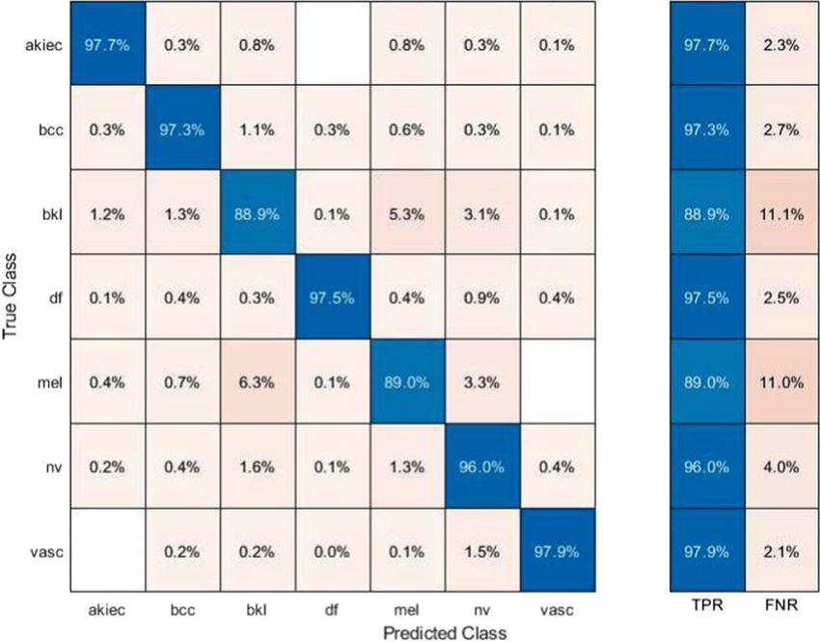
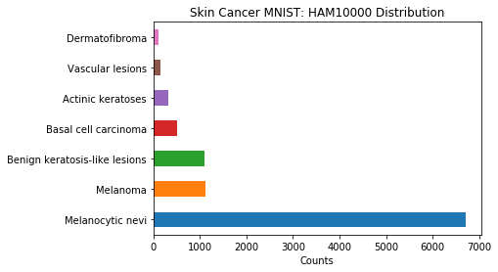
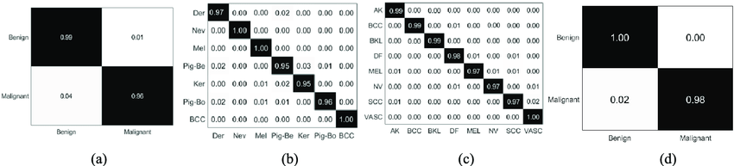
Math behind the ai
True Positive (TP)
False Positive (FP)
Precision = TP/(TP+FP)
Recall = TP/(TP+FN)
HAM10000
Actinic Keratosis
Precision = 97.8%
Recall = 97.7%
Basal Cell Carcinoma
Precision = 96.7%
Recall = 97.3%
Benign Keratosis
Precision = 89.6%
Recall = 88.9%
Dermatofibroma
Precision = 99.3%
Recall = 97.5%
Melanoma
Precision = 91.3%
Recall = 89.2%
Melanocytic Nevus
Precision = 91.1%
Recall = 96.0%
Vascular Lesion
Precision = 98.9%
Recall = 97.9%
Confusion matrix (a) ISIC 2017 (b) ISBI 2018 (c) ISBI 2019 (d) ISIC 2020.
Notes:
To continue applying information from lecture, we will show some of the math behind the AI.
Here is the confusion matrix of cubic SVM using selected features fusion for HAM10000
Confusion matrix for the ISIC and ISBI, but we will focus on the ISIC.
TPR – True Positive Rate where the model correctly predict the positive class
FNR – False Negative Rate shows the probability that a true positive will be missed by the test
Precision tells you how much you can trust your classifier when it tells you an instance belongs to the positive class.
Recall tells you how many of the total numbers of positive instances were correctly classified.
Cancer diagnosis is an example where false positives are more acceptable than false negatives. It's ok if you misclassify healthy people as members of the positive class (has cancer). Missing a person who needs treatment, on the other hand, is something you don't want. In this type of problems, you want very high recall values: find as many members of the positive class as possible

Slide 10
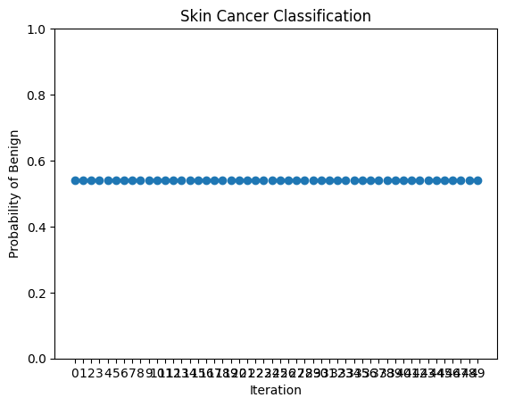
Final_test1
CNN created by “SULEEE” – trained with the International Skin Imaging Collaboration: Melanoma Project ISIC
Benign Images: 1208
Malignant Images: 849
Code – Loads model from GitHub, Loads image from user files, Preprocesses the image, Makes a prediction and calculates the probability
Result Example
Melanoma submission
Predicted class: Benign
Probability: 53.97%
Graph of the probability over 50 iterations of the image
Consistent results
Notes:
With 2057, the CNN is not good at recognizing outside images. Therefore, all the images I submitted to the code gave the same results no matter the image.

Slide 11
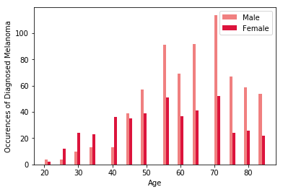
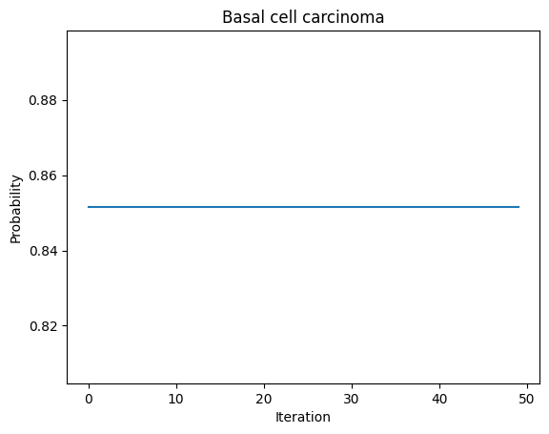
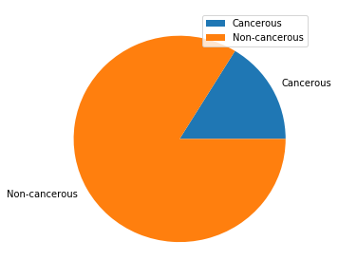
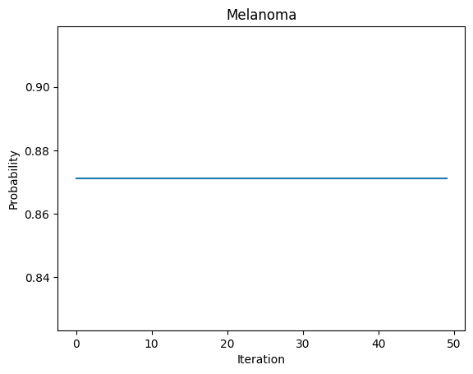
Final_test2
CNN created by “akaashsidhu” – trained with the HAM10000 dataset
Code – Loads model from GitHub, Loads image from user files, Preprocesses the image, Makes a prediction and calculates the probability
Result Examples
Basal Cell Carcinoma submission
Predicted class: Basal cell carcinoma
Probability: 85.16%
Melanoma submission
Predicted class: Melanoma
Probability: 87.12%
Graph of the probability over 50 iterations of the image
Consistent results
Notes:
Classes:
Melanocytic nevi (nv) are benign (non-cancerous) neoplasms composed of melanocytes.
Melanoma is a type of cancer that develops from melanocytes. It is the most dangerous type of skin cancer and is more common among men than women and high rates are found in Northern Europe and North America in areas mostly populated with white people.
Benign keratosis-like lesions are non-cancerous skin growths. They are often found on the back or chest and they grow slowly either in groups or singly. It is very likely that everyone will develop one keratosis-like lesion in their lifetime.
Basal cell carcinoma is a type of skin cancer that begins in the basal cells (which produce new skin cells) and occurs frequently in areas exposed to the sun (e.g., head or neck).
Actinic keratoses is a non-cancerous rough, scaly patch on your skin that develops from years of exposure to the sun. It's most commonly found on your face, lips, ears, back of your hands, forearms, scalp or neck.
Vascular lesions include acquired lesions (eg, pyogenic granuloma) and those that are present at birth or arise shortly after birth (vascular birthmarks).
Dermatofibroma is a common cutaneous nodule of unknown etiology that occurs more often in women. It develops frequently in the extremities (i.e., lower legs) and is usually asymptomatic.
Overall, the test performance of the model is approximately 90% while the testing of the model yielded 81%.

Slide 12
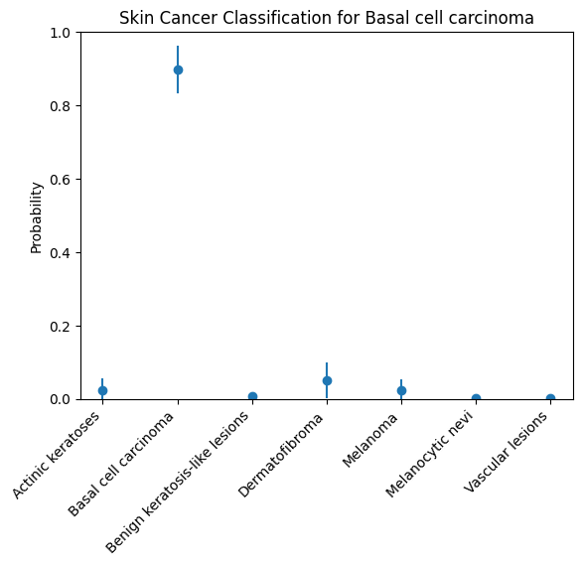
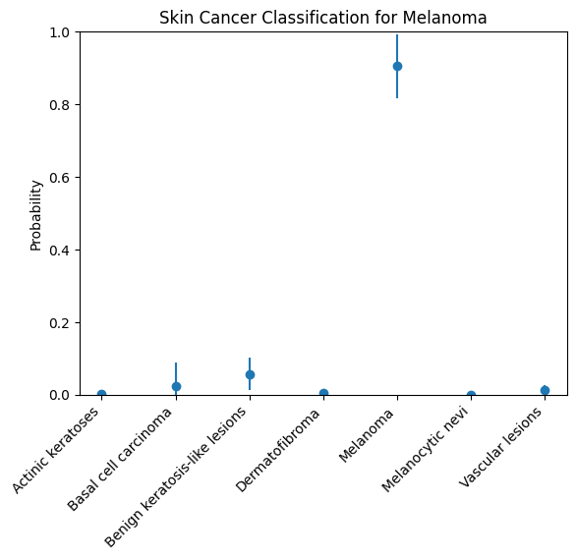
Final_test3
CNN created by “akaashsidhu” – trained with the HAM10000 dataset with improvements
Improvements
Result Examples
Basal Cell Carcinoma submission
Predicted class: Basal cell carcinoma
Probability: 90.29%
Melanoma submission
Predicted class: Melanoma
Probability: 94.17%
Graph of the probability over 50 iterations of the image
Consistent prediction class
Probability is less consistent
Notes:
Here, I added an image augmentation step using the ImageDataGenerator function from Keras. This function applies various transformations to the input image, such as rotation, shifting, shearing, and zooming, to create additional training data and improve the model's performance. I also added the horizontal_flip parameter to randomly flip the image horizontally, which can help the model better generalize to new data. Finally, I applied the fill_mode parameter to handle any pixels that are lost or created during the image transformations.
After generating the augmented image, I used the same code as before to make a prediction with the model and decode the output into the predicted class and probability. This code should provide a more accurate prediction than the original code by accounting for variations in the input image.

Slide 13
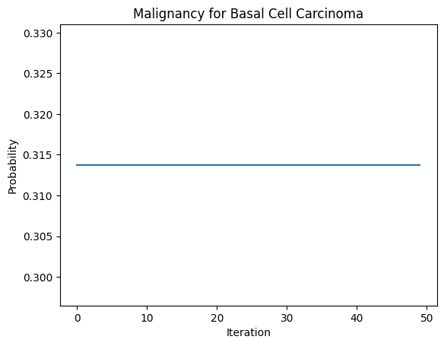
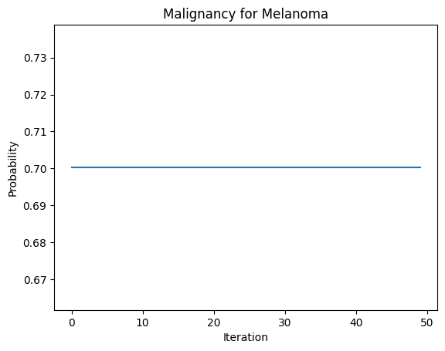
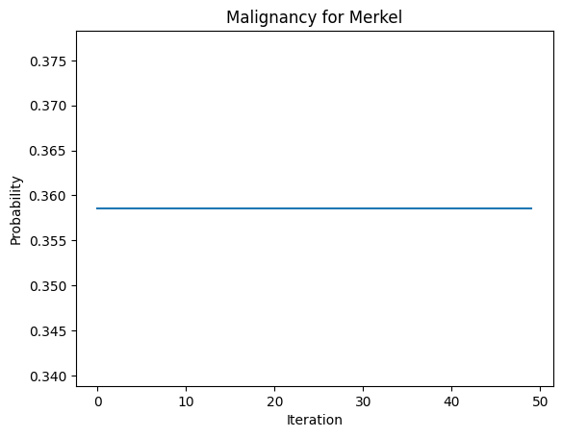

Final_test4
CNN created by “PRASHANT JESWANI TEJWANI” – trained with the SIIM-ISIC dataset
Code – Loads model from Kaggle downloads, Loads image from user files, Preprocesses the image, Makes a prediction and calculates the probability
Result Examples
Basal Cell Carcinoma submission
Malignant Probability: 31.37%
Melanoma submission
Malignant Probability: 70.03%
Merkel submission
Malignant Probability: 35.86%
Squamous submission
Malignant Probability: 54.40%
Graph of the probability over 50 iterations of the image
Consistent results
Notes:
This code loads a pre-trained machine learning model from Google Drive and makes a prediction on a new image uploaded by the user.
The model used is a weighted model, which is a type of deep learning model that has been trained on a large dataset of images to recognize certain patterns and classify images into different categories. In this case, the model is designed to classify images as either malignant or benign.
The user is prompted to upload an image file, which is then preprocessed using an ImageDataGenerator object from the Keras library. This object applies a series of transformations to the image, such as rotation, shifting, shearing, and zooming, in order to increase the variability of the dataset and improve the performance of the model. The preprocessed image is then resized to match the input size of the model (224 x 224) and normalized by dividing each pixel value by 255.
The preprocessed image is then passed to the pre-trained model, which makes a prediction on the image and returns a probability distribution over the two classes (malignant or benign). The code then decodes the prediction by finding the index of the highest probability and mapping it to the corresponding class name. Finally, the code prints the predicted class and the associated probability as a percentage.

Slide 14
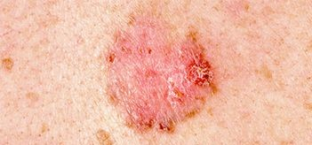
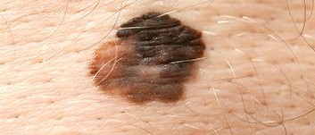
Final_test5
Code – Combination of Final_Test3 and Final_Test4 CNNs to give more information to the user when they upload the image
Result Examples
Basal Cell Carcinoma submission
Predicted class: Basal cell carcinoma
Basal cell carcinoma Probability: 92.99%
Malignancy Probability: 0.29%
Melanoma submission
Predicted class: Melanoma
Melanoma Probability: 96.78%
Malignancy Probability: 99.47%
Notes:
The code above is the combined CNN from Final_Test3 and Final_Test4. The goal is to predict the type of skin lesion and its malignancy probability.
The first model is a pretrained CNN that classifies skin lesions into seven types using transfer learning. The model is loaded from a pretrained model file, and an image is uploaded for prediction. The image is preprocessed and augmented with the ImageDataGenerator object from the Keras library. The model predicts the type of skin lesion and probability that the prediction is right.
The second model is a pretrained CNN that predicts the malignancy probability of skin lesions. The model is loaded from a pretrained model file, and an image is uploaded for prediction. The image is preprocessed and resized to match the input size of the model. The model predicts the malignancy probability.
With the improvements to the Final_Test3, the results of the Final_Test4 are also affected.
The two models are combined by loading both models and passing the preprocessed image to both models. The predicted class from the first model and the predicted probability from the second model are then printed.
The malignancy probability are going to be different based on each individual image; however, based on these images the probability is more than likely accurate for the Basal and Melanoma.

Slide 15
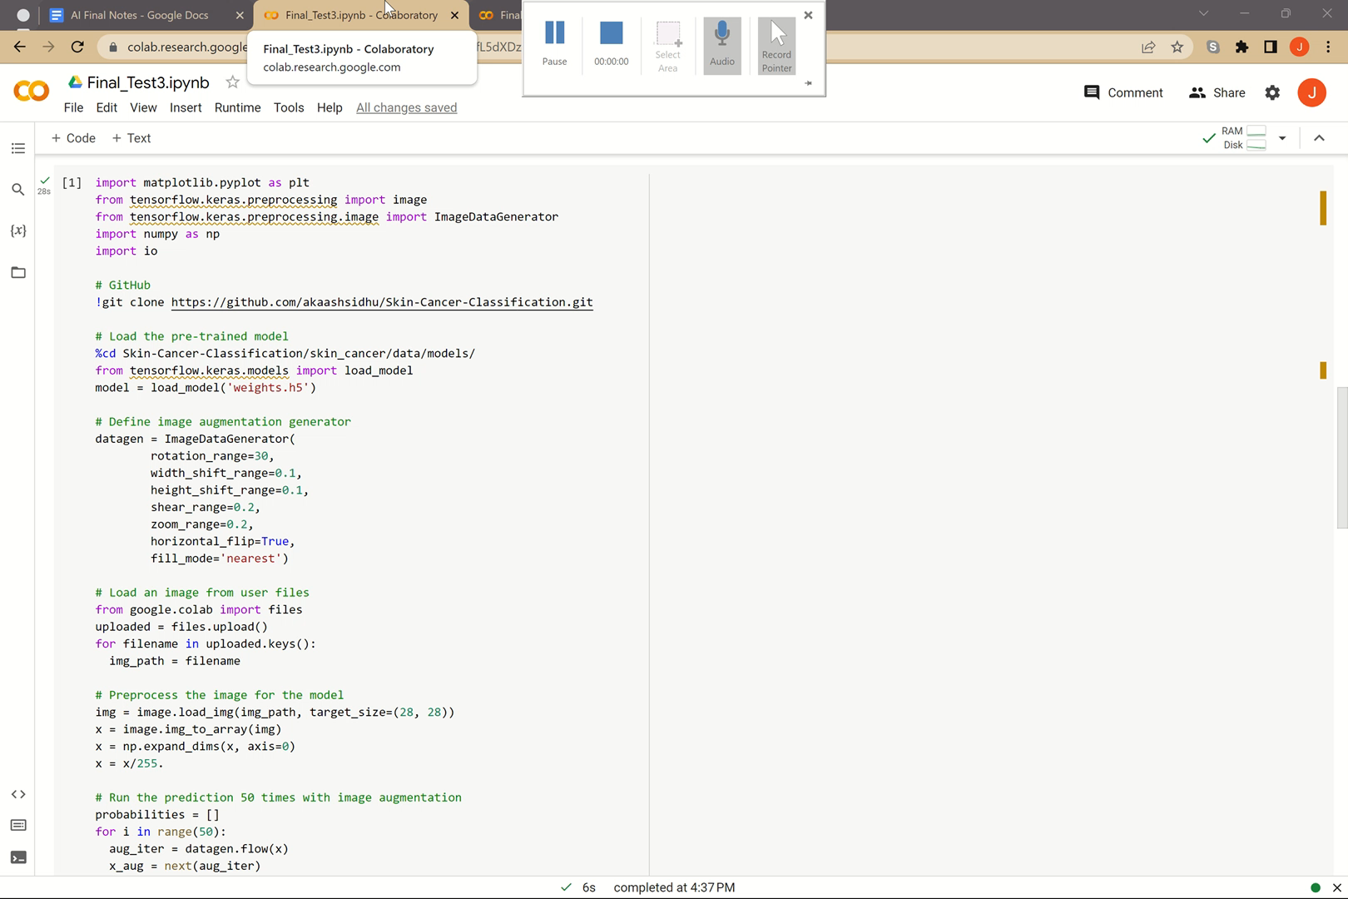

Demonstration
I will now demonstrate codes for Final_Test3 and Final_Test5 so you are able to see the type graph as well as the final improvements.

Slide 16
conclusion
According to multiple medical references, more than two people die of skin cancer in the U.S. every hour. However, when detected early, the 5-year survival rate for melanoma is 99 percent.
My contribution to Skin Cancer AI detection includes making CNNs more user friendly and combining the CNNs to improve the information given to the user.
Using AI for early diagnosis in skin cancer detection, has the potential to further the development of the medical field and ability to save millions of lives.
Notes:
This tool has been designed only for educational purposes to demonstrate the use of Machine Learning tools in the medical field. This tool does not replace advice or evaluation by a medical professional. Nothing on this site should be construed as an attempt to offer a medical opinion or practice medicine.

Slide 17
Works Cited - Midterm
Adminmdh, and Adminmdh. “Types of Skin Cancers: Dermatologist Woodlands: Houston: Katy Texas.” Dermatologist Houston Texas | The Woodlands, 1 Sept. 2017, https://mohsdermhouston.com/types-of-skin-cancers/.
Esteva, Andre, et al. “Dermatologist-Level Classification of Skin Cancer with Deep Neural Networks.” Nature News, Nature Publishing Group, 25 Jan. 2017, https://www.nature.com/articles/nature21056.
Esteva, Andre. “Skin Cancer Classification with Deep Learning.” Dermatologist-Level Classification of Skin Cancer with Deep Neural Networks, https://cs.stanford.edu/people/esteva/nature/.
Messier-16. “Messier-16/Skinskan: $10,000 Grand Prize Winner - International Health Ai Hackathon Project - Skin Cancer Recognition App.” GitHub, 2019, https://github.com/Messier-16/Skinskan.

Slide 18
Works Cited – Additional for Final
“Find and Share Research.” ResearchGate, https://www.researchgate.net/.
Marks, Julie Lynn, et al. “What Are the Different Types of Skin Cancer?” EverydayHealth.com, https://www.everydayhealth.com/skin-cancer/what-are-the-different-types-of-skin-cancer/.
Sidhu, Akaash, and Mandy Gu. “Akaashsidhu/Skin-Cancer-Classification: This Project Aims to Use a Convolutional Neural Network (CNN) to Classify 7 Classes of Skin Lesions.” GitHub, 5 Apr. 2020, https://github.com/akaashsidhu/Skin-Cancer-Classification.
Suleee, and David Soto. “Suleee-Ai/Skin-Cancer-Detection-Using-CNN-Classifier: This Project Uses Convolutional Neural Network (CNN) to Detect Malignant Skin Cancer Moles.” GitHub, 9 Dec. 2020, https://github.com/SULEEE-AI/Skin-Cancer-Detection-using-CNN-Classifier.
Tejwani, Prashant Jeswani. “Models.” Kaggle, 3 Dec. 2021, https://www.kaggle.com/datasets/prashantjeswani/models.
Notes:
And that brings us to the end. I’d like to thank you for your time and attention today.

